Slide 1
Quantitative Data analysis with SPSS
Nowadays, rather than having to calculate the mathematical equations for our data analysis ourselves, we will usually get software packages to do this.
There is a variety of packages out there that do quantitative data analysis : SPSS, Xlstat, SAS, Stata, Excel and other spreadsheet software allow quantitative data analysis.

Slide 2
Introduction to SPSS
SPSS is probably the most common statistical data analysis software package used in social science research.
It is also quite user-friendly and does everything we need it to do. This does not mean that it is necessarily ‘better’ than any of the other packages.
Other packages may be better in some areas, but in management science, SPSS is by far the most commonly used statistical data analysis software.
Let’s have a look what SPSS is like. When we open SPSS, we get the screen shown in Figure 5.1.
■ ■ ■

Slide 3
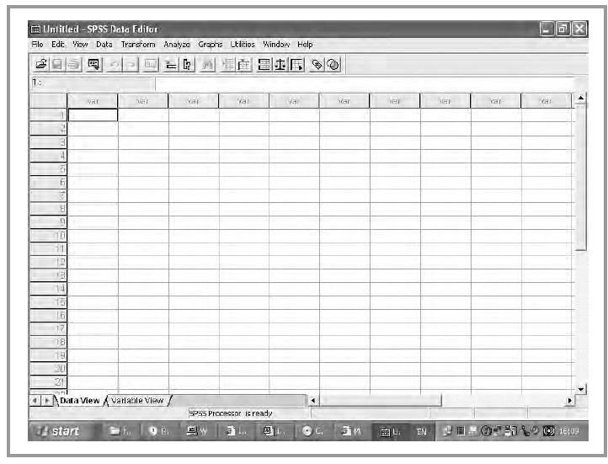
When we open SPSS, we get this screen (Figure 5.1.)
This is where (once we have opened a file) we will find the variables and the units/observations. Our units/observations are the rows, numbered from 1 to however many people we have in our study. The variables are the columns. The names appear at the top of the grid (where it now says ‘var’).

Slide 4
The top row has a number of names, like ‘file’, ‘edit’, ‘view’ , ‘Data’,‘Transform’, ‘Analyze’, etc.
This is where we will find our data analysis tools which we will be discussing in the next chapters.
Now we can see that the values for all variables for every unit/observation have
appeared in the grid (see Figure 5.2).

Slide 5
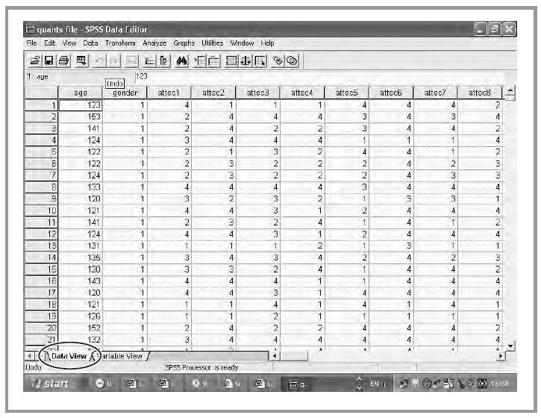
The value of the variable ‘age’ for unit or respondent 1 is 123, for example (age is calculated in months here ! ).
Test with AirBnB Data

Slide 6
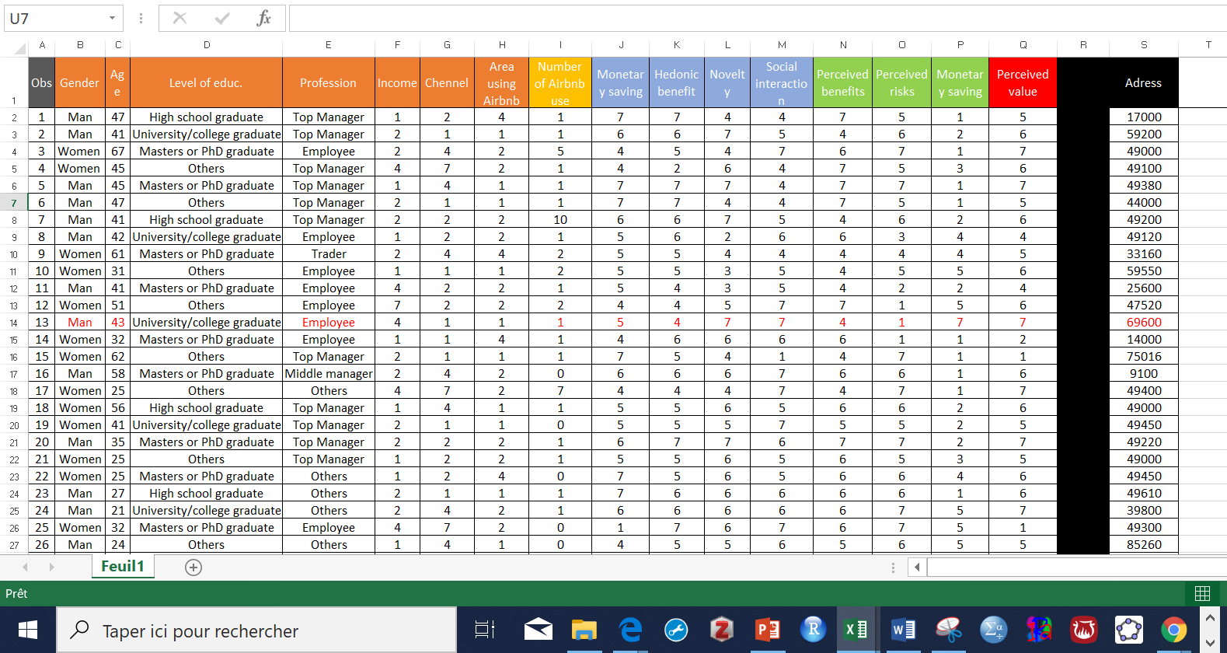
The antecedents of perceived value in the Airbnb context
Aubrey Stollery & Soo Hyun Jun (201)
Univariate statistics

Slide 7
Univariate statistics
While it may be tempting to start looking at relationships between variables straight away, it is a good idea to look at our individual variables first.
We usually need to know how our respondents have replied to particular questions before we can go and look at relationships with other variables.
We might often just want to know how many Men and Women are in our sample.
This kind of descriptive information can give us useful information on our variables and our research questions. Because we are looking at individual variables, this type of analysis is called univariate analysis.

Slide 8
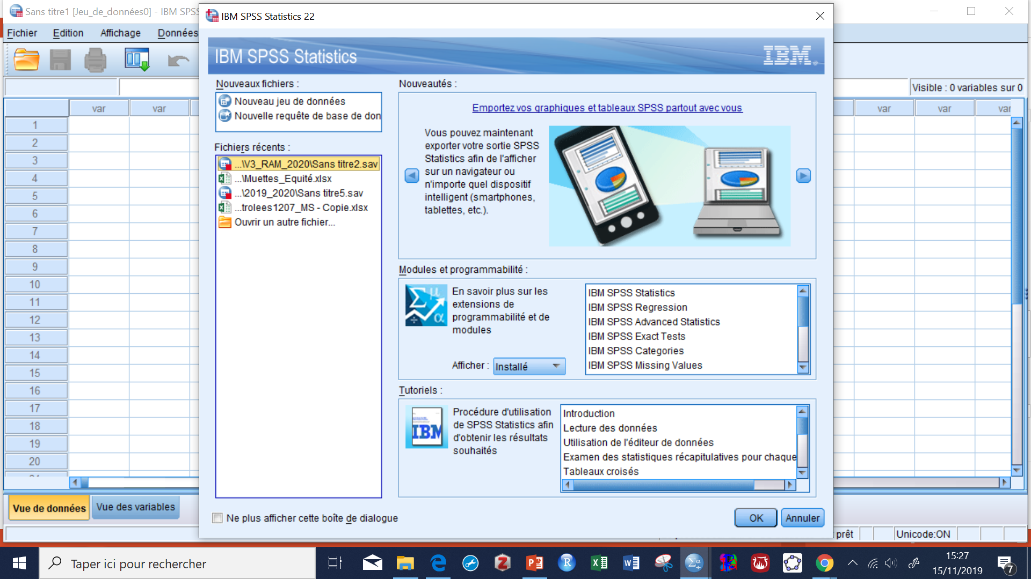
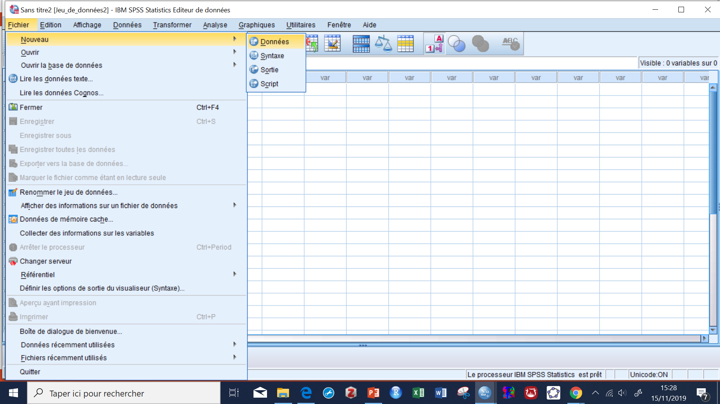
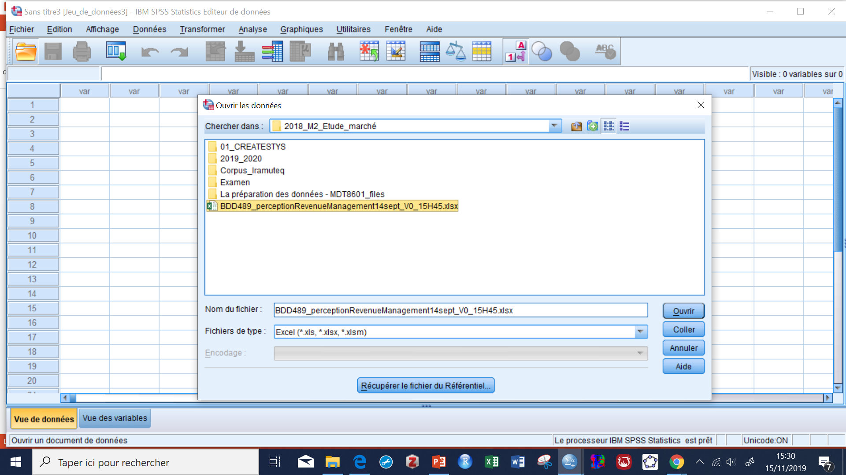
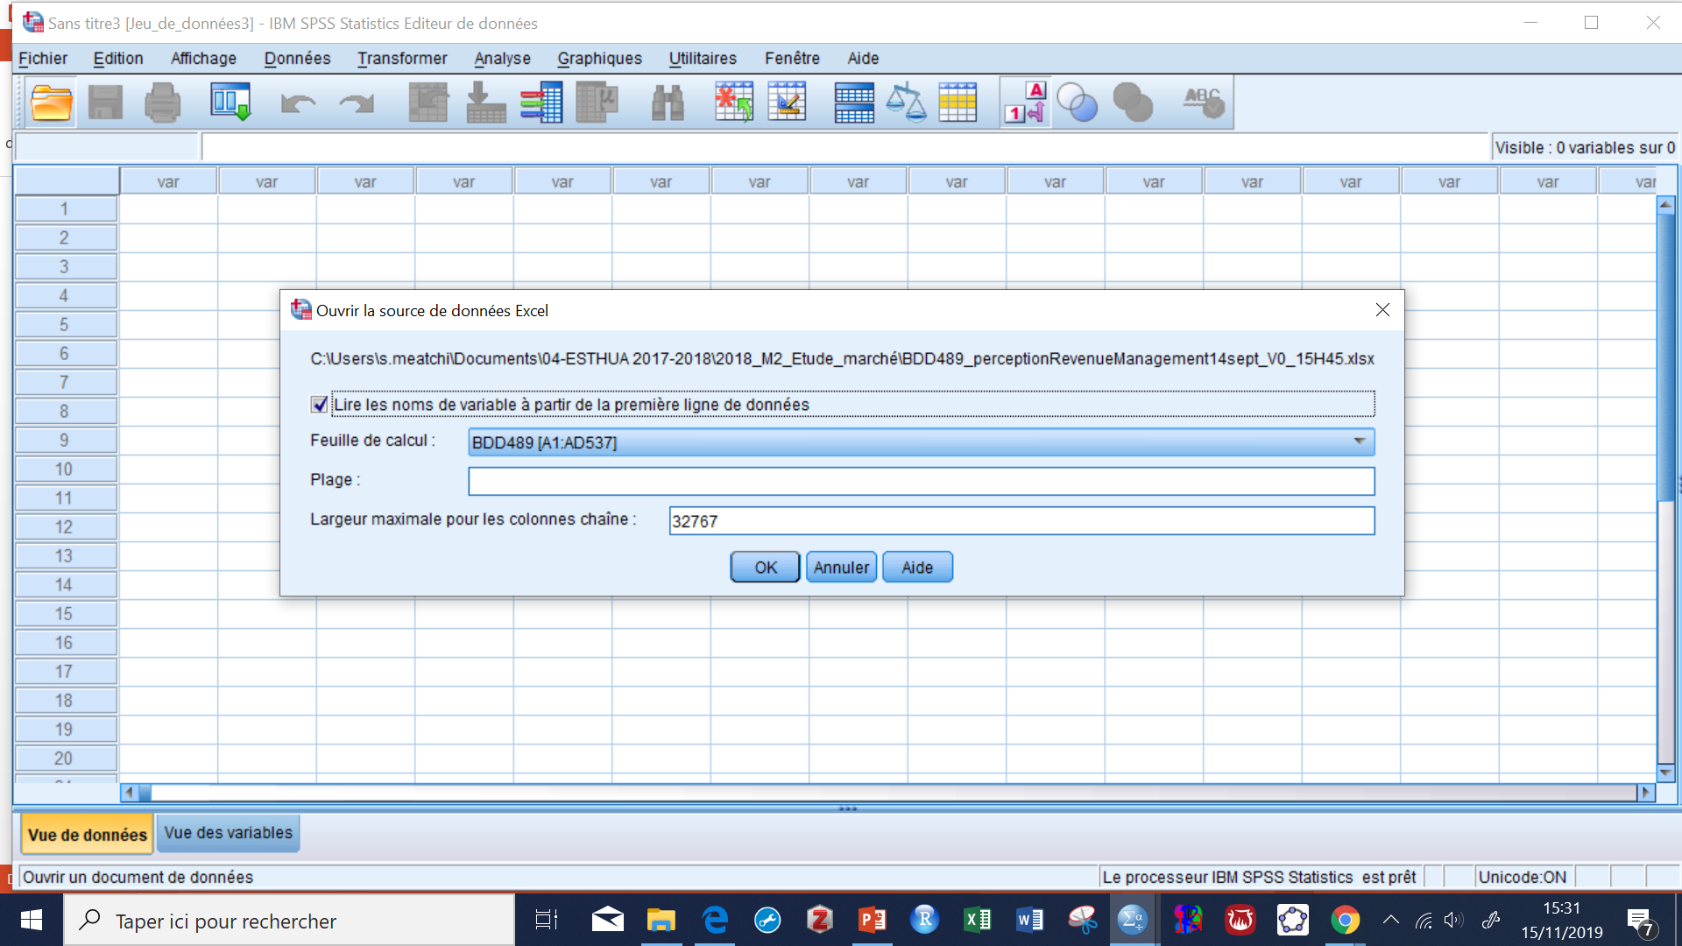

Slide 9
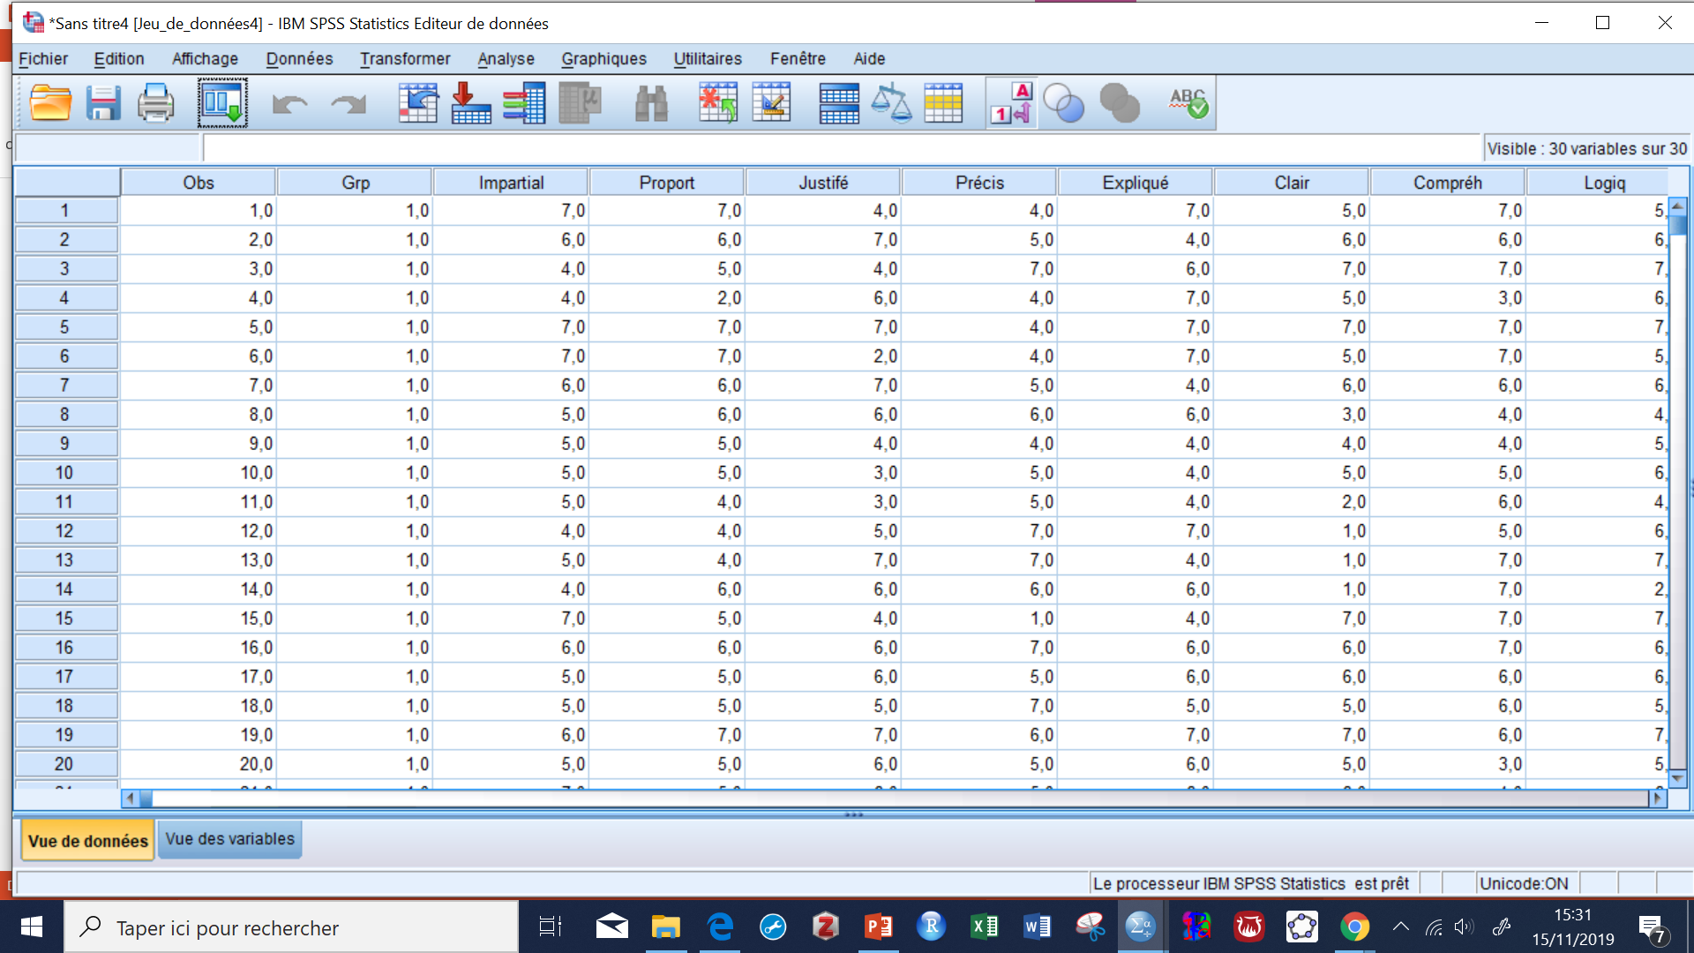
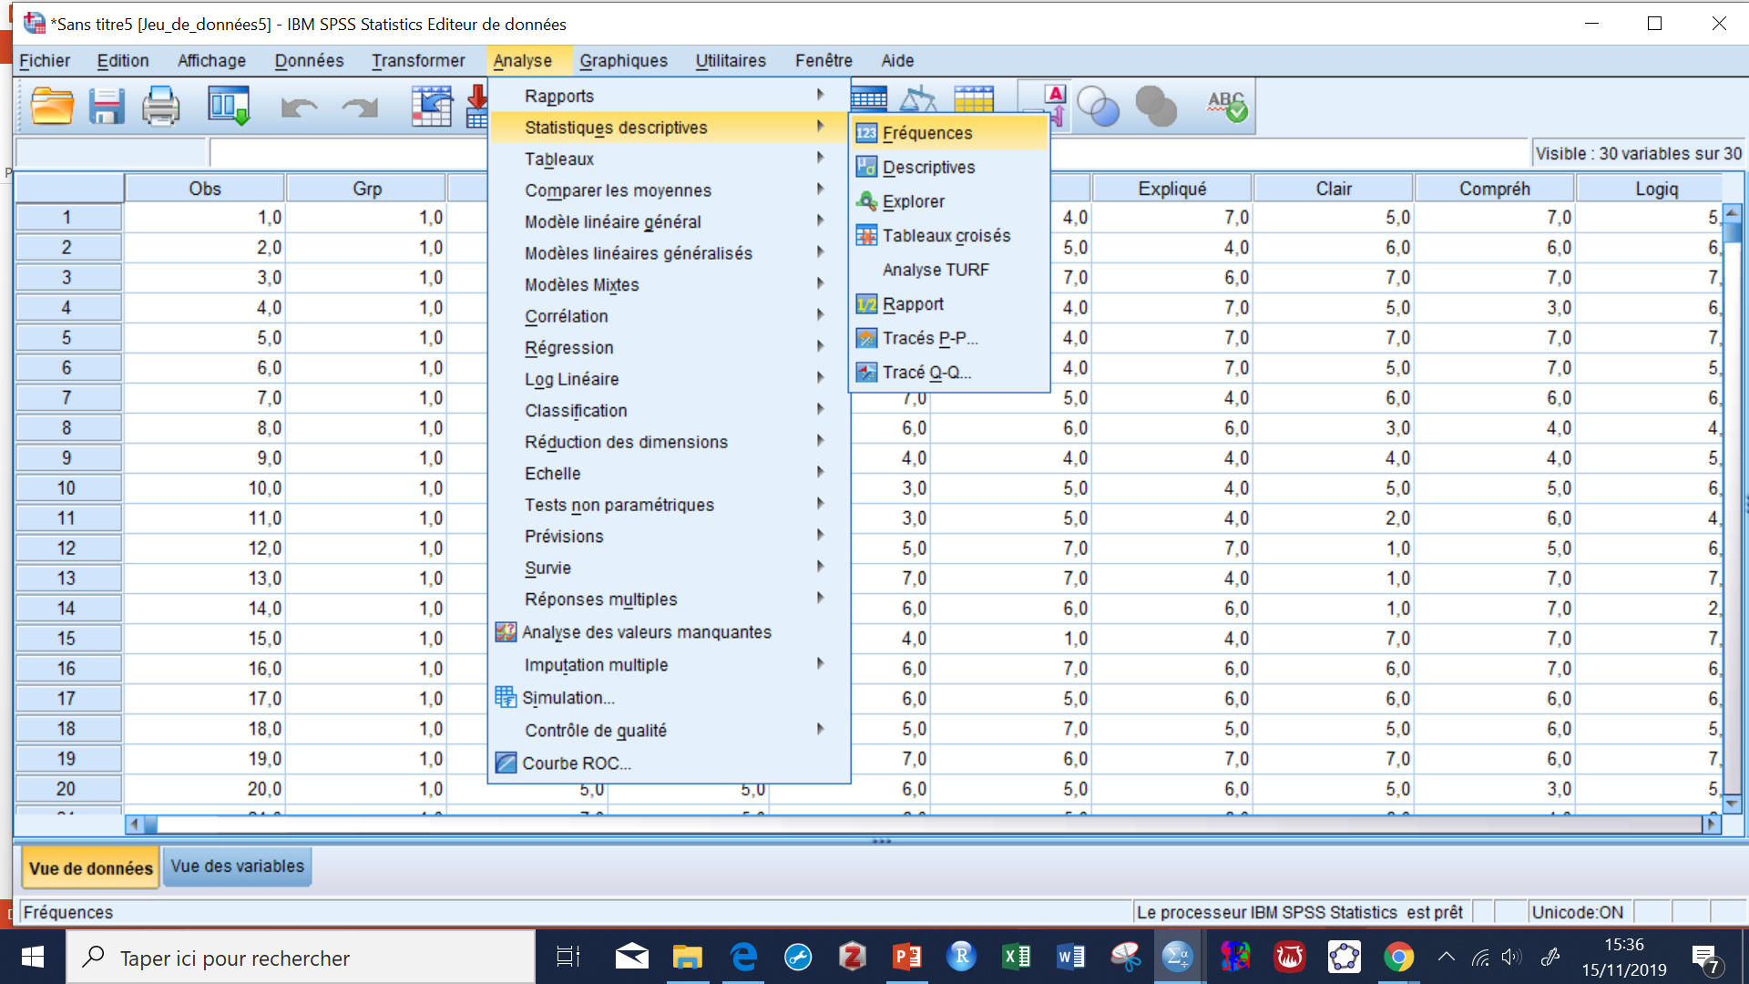
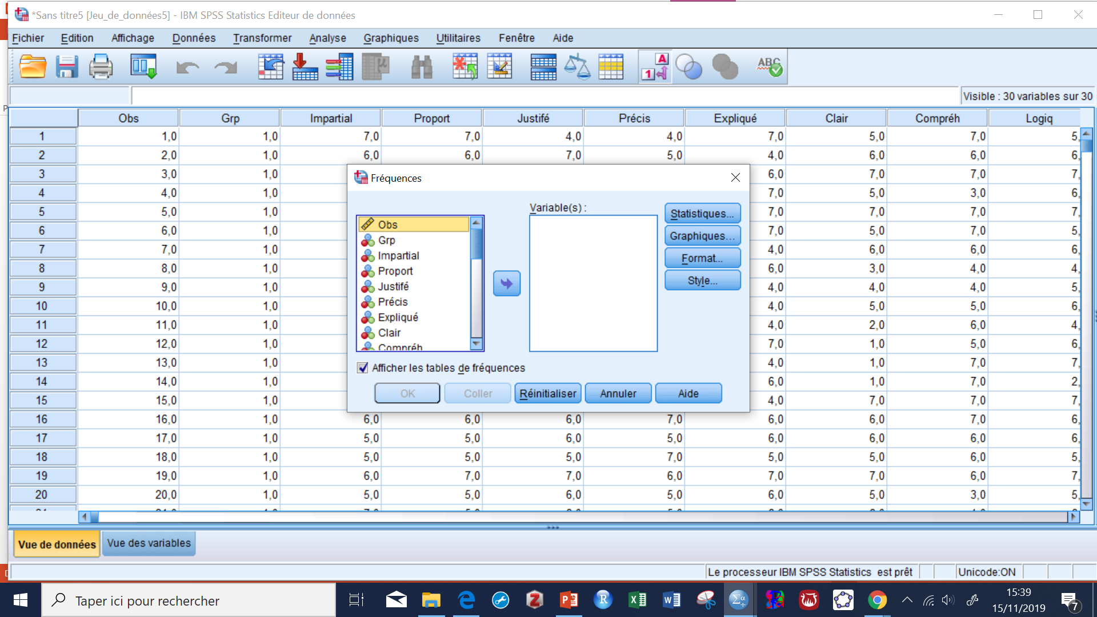
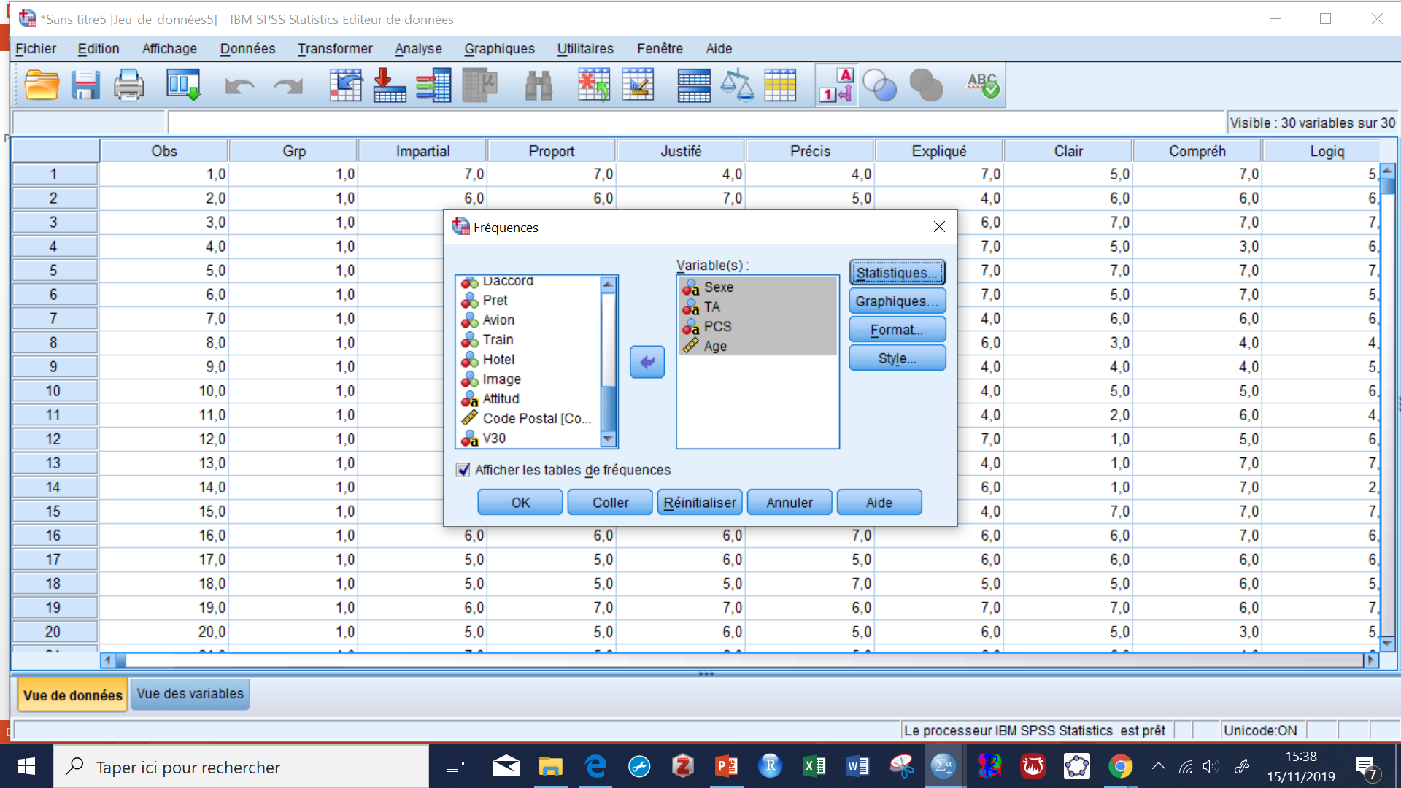

Slide 10
